Slide 1
Enterprise Architecture Modeling With ArchiMate & Sparx
Adnaan Sikandar
Capgemini Canada Inc.
Adnaan.Sikandar@capgemini.com

Slide 2
Agenda
ArchiMate Overview
ArchiMate Concepts
Framework & Concept
Layers
Metamodels
ArchiMate Viewpoints
Information Structure Viewpoint
Business Process Viewpoint
Layered Viewpoint
Infrastructure Viewpoint
TOGAF ADM Viewpoints

Slide 3
ArchiMate
What is it?
ArchiMate is a modeling language for describing enterprise architectures
Broader scope than UML. UML is for software engineering
Supports EA frameworks like TOGAF & Zachman
Can be used to create IAF views and artifacts
ArchiMate viewpoints are more detailed than TOGAF’s architecture artifacts – TOGAF does not provide descriptions and examples

Slide 4
ArchiMate
Which version should I use?
Technical Specification 1.0 (Approved)
Technical Specification 2.0 (Under Review)
Is it a standard?
The Open Group’s ArchiMate Forum – Stewards of the ArchiMate standard
What about the license?
Capgemini is an ArchiMate Forum member
ArchiMate Forum members have commercial license to use it for consulting engagements

Slide 5
ArchiMate – Concepts

Slide 6
ArchiMate Framework
Products & Services
Business
Functions
Business
Information
Processes
Organisation
Data
Applications
Application
Technical Infrastructure
Technology
Information
Behavior
Structure

Slide 7
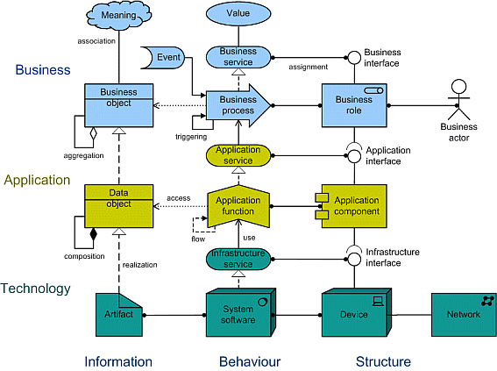
ArchiMate Concept

Slide 8
ArchiMate Structure - Services
Customer
External
business service
Business
Internal
business service
External
application service
Application
Internal
application service
External
infra. service
Technology
Internal
infra. service

Slide 9
ArchiMate Structure - Layers
Layers
Business Layer - Offers products and services to external customers, which are realized in the organization by business processes performed by business actors
Application Layer - Supports the business layer with application services which are realized by (software) applications.
Technology Layer - offers infrastructure services (e.g., processing, storage, and communication services) needed to run applications, realized by computer and communication hardware and system software.
Generic Metamodel For Each Layer
External
Internal
Information
Behavior
Structure

Slide 10
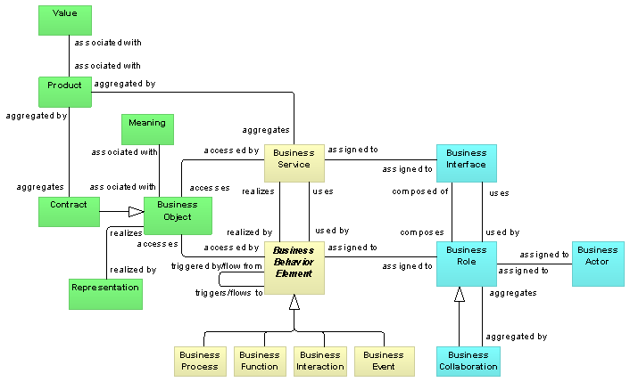
Metamodel – Business Layer

Slide 11
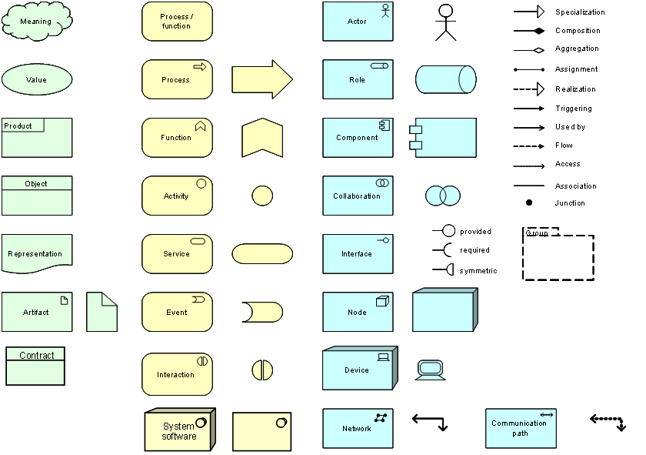
Language Notations

Slide 12
Business Layer - Sparx Example

Slide 13
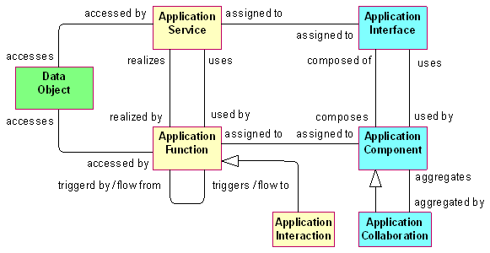
Metamodel – Application Layer

Slide 14
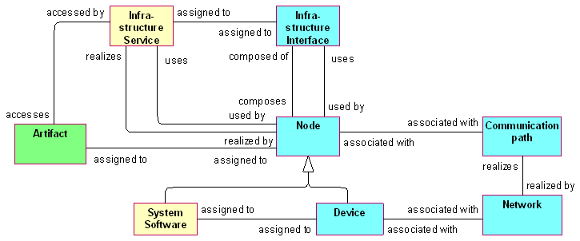
Metamodel – Technology Layer

Slide 15
ArchiMate – Viewpoints

Slide 16
Basic ArchiMate Viewpoints
Introductory Viewpoint
Organization Viewpoint
Actor Co-operation Viewpoint
Business Function Viewpoint
Business Process Viewpoint
Business Process Co-operation Viewpoint
Product Viewpoint
Application Behavior Viewpoint
Application Co-operation Viewpoint
Application Structure Viewpoint
Application Usage Viewpoint
Infrastructure Viewpoint
Infrastructure Usage Viewpoint
Implementation and Deployment Viewpoint
Information Structure Viewpoint
Service Realization Viewpoint
Layered Viewpoint
Landscape Map Viewpoint

Slide 17
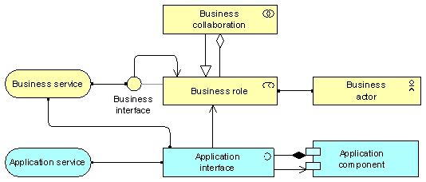
Actor Co-Operation Viewpoint
Layered View Point
Stakeholders | Enterprise, process, and domain architects
Concerns | Relations of actors with their environment
Purpose | Designing, deciding, informing
Abstraction Level | Details
Business layer | Business layer
Aspects | Structure, behavior

Slide 18
Actor Co-Operation Viewpoint

Slide 19
Layered Viewpoint
Layered View Point
Stakeholders | Enterprise, process, application, infrastructure, and domain architects
Concerns | Consistency, reduction of complexity, impact of change, flexibility
Purpose | Designing, deciding, informing
Abstraction Level | Overview
Layer | Business layer, application layer, technology layer
Aspects | Information, behavior, structure

Slide 20
Layered Viewpoint – Sparx Example

Slide 21
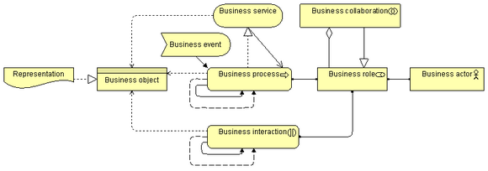
Business Process View Point
Business Process View Point
Stakeholders | Process and domain architects, operational managers
Concerns | Structure of business processes, consistency and completeness, responsibilities
Purpose | Designing
Abstraction Level | Detail
Layer | Business layer
Aspects | Behavior

Slide 22
Business Process View Point – Sparx Example

Slide 23
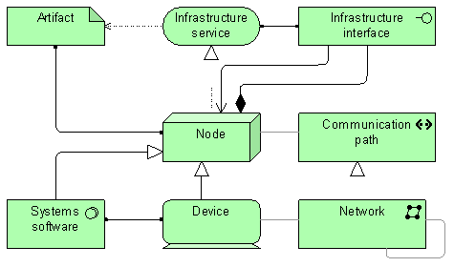
Infrastructure View Point
Business Process View Point
Stakeholders | Infrastructure architects, Operational Managers
Concerns | Stability, security, dependencies, infrastructure costs
Purpose | Designing
Abstraction Level | Detail
Layer | Technology
Aspects | Behavior, Structure

Slide 24
Infrastructure View Point – Sparx Example

Slide 25
Application Landscape View Point
Baseline Application Model
Target Application Model

Slide 26
ArchiMate Resources
ArchiMate 1.0 Technical Specification
ArchiMate Good Practices
Sparx Enterprise Architect
ArchiMate Presentations

